Slide 1
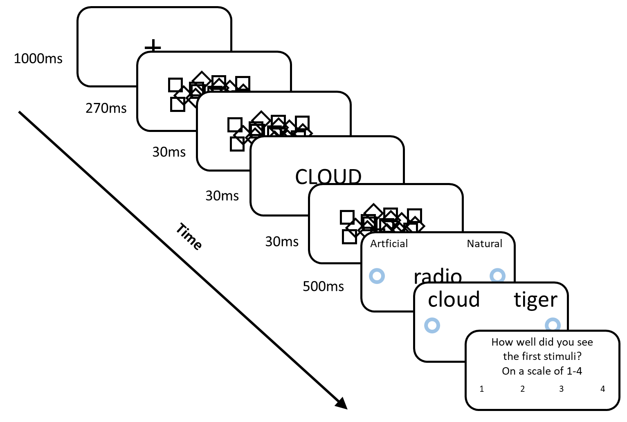

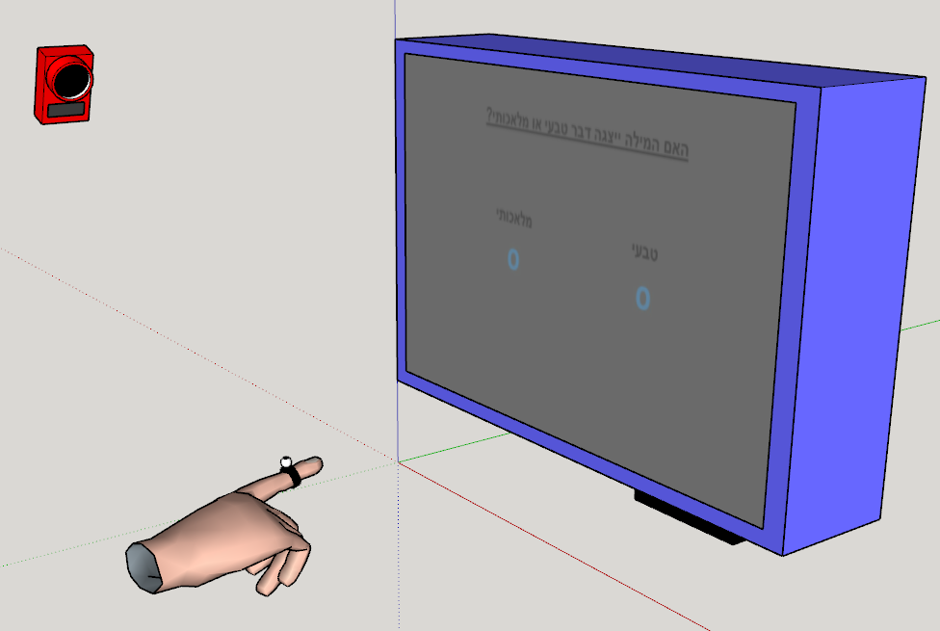
Primed Trajectory
Notes:
My experiment is a rather simple priming experiment.
A masked prime is displayed to the subjects, followed by a target word.
These words can describe natural / artificial items.
After both words are displayed, the subjects are asked to categorize the target as natural / artificial.
Once they do that, they are shown two words, from which they have to recognize the prime.
Finally the subjects answer a PAS about the prime.
The twist is in the way we record the subject’s answers:
The answers are displayed on the screen and the subject is asked to reach the correct answer.
We track the trajectory of his hand, and that is used as the measure for unconscious processing in our analysis.
Our goal is to find out if motion tracking is sensitive to unconscious priming effects, as it wasn’t used for such goals before.
We expect that the trajectory on incongruent trials will be biased to the center due to conflicting category of the prime and the target.

